Slide 1

HR Attrition Analytics Dashboard Presentation
Executive Business Insights
POWER BI

Slide 2


The Business Challenge
Employee attrition is one of the most costly workforce challenges organizations face — driving up recruitment costs, disrupting productivity, and eroding institutional knowledge. For IBM, understanding who is leaving and why is essential to maintaining a competitive, engaged workforce.
Project Objective: Build an interactive Power BI dashboard that enables leadership to monitor attrition trends, identify high-risk employee segments, and take proactive, data-driven action.

Slide 3
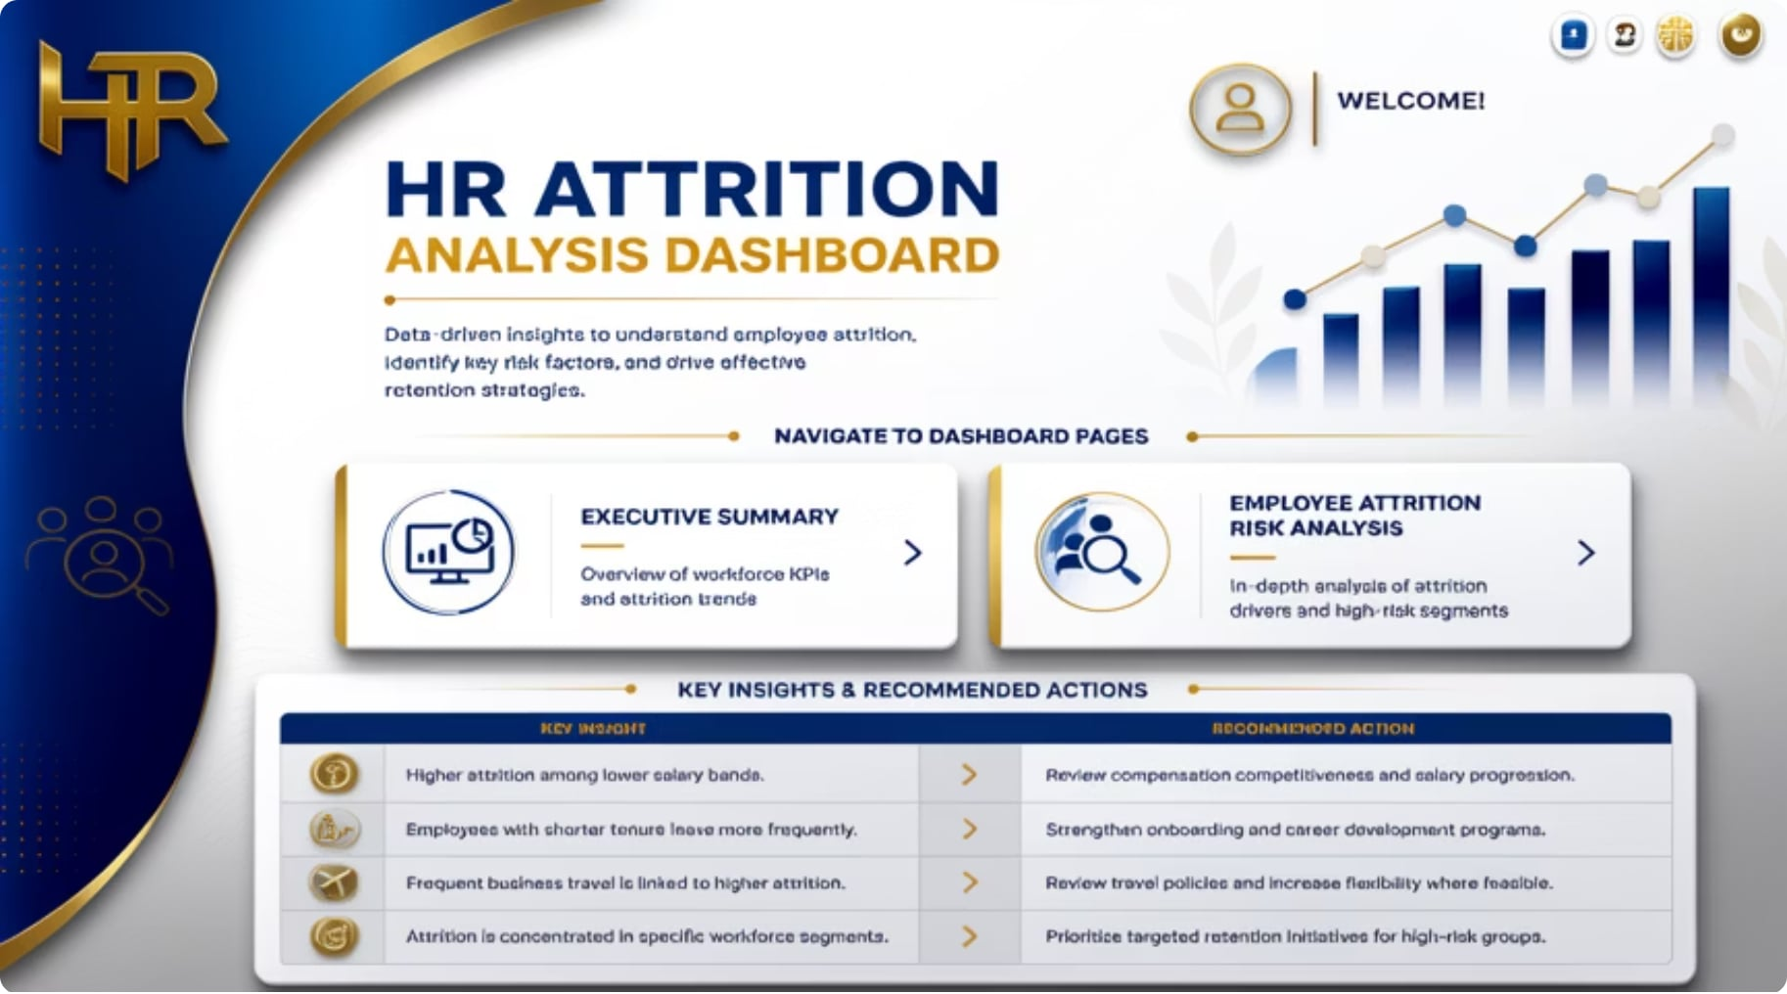

Dashboard Overview
The dashboard is structured across two interactive views, designed for executive-level consumption and drill-down analysis.
Interactive filters allow stakeholders to drill into specific departments, job roles, and demographics in real time.
Executive Summary
Employee Attrition Risk Analysis
High-level KPIs, attrition rates, and workforce trends at a glance.
Segmented risk breakdowns by department, role, age, and salary band.

Slide 4
Executive Summary — Key KPIs
1,470
237
Total Employees
Employees Left
16.1%
83.9%
Attrition Rate
Retention Rate
Executive Insight: While 83.9% retention appears stable, a 16.1% attrition rate represents 237 departures — each carrying significant replacement cost and productivity impact.

Slide 5
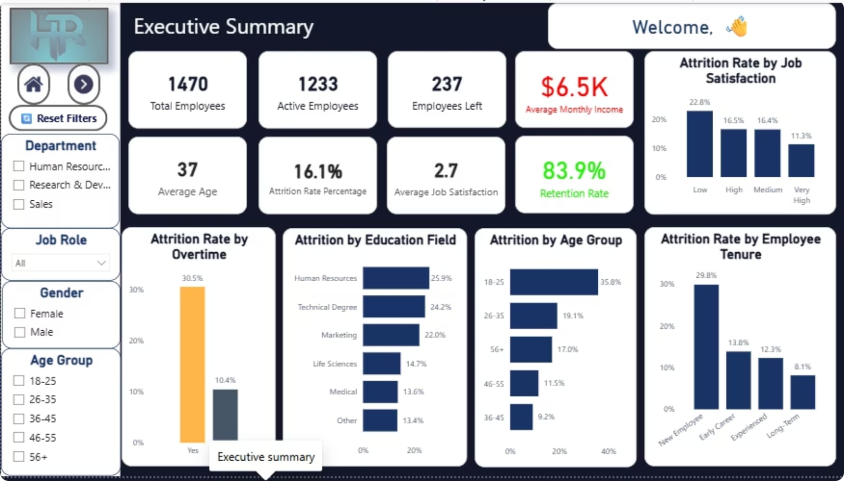


Key Findings
These five factors indicate that workload, early-career experience, and job satisfaction are the primary levers for reducing attrition.
Overtime Drives Attrition
Youngest Employees at Highest Risk
New Hires Are Vulnerable
30.5% attrition with overtime vs. 10.4% without
29.8% attrition among newer employees
Ages 18–25 show 35.8% attrition
Low Satisfaction Accelerates Departures
HR Education Field Leads Attrition
22.8% attrition for low job satisfaction
25.9% attrition — highest by education field

Slide 6

Executive Summary Dashboard

Slide 7
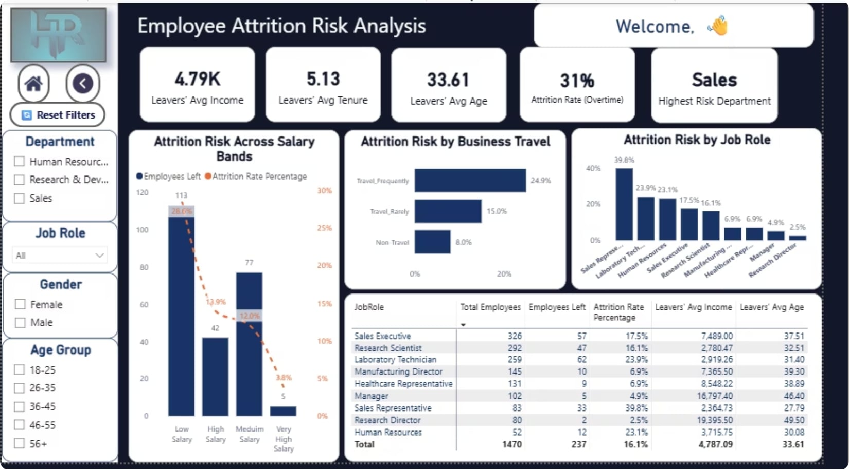

Employee Risk Analysis
The Risk Analysis view identifies the highest-risk segments requiring immediate leadership attention.
Business Conclusion: Sales teams — particularly representatives with high travel demands and lower compensation — represent the most critical retention priority.
🏢 Highest-Risk Department
👤 Highest-Risk Job Role
✈️ Frequent Business Travel
💰 Low Salary Band
28.6% attrition in the lowest compensation tier
Sales — consistently elevated attrition across roles
Sales Representative — highest individual role risk
24.9% attrition among frequent travelers

Slide 8
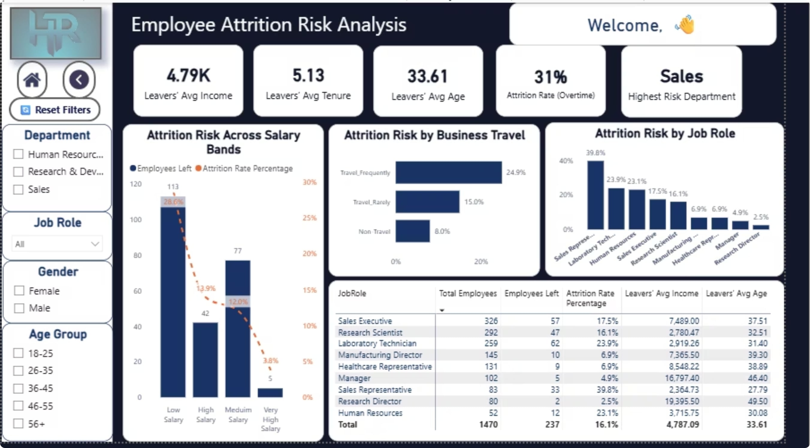
Employee Risk Analysis

Slide 9



Security & Strategic Recommendations
Role-Based Access (RLS)
Role-Based Access ensures that sensitive employee data is visible only to authorized users. This control framework strengthens data security, supports compliance, and gives each leader access only to the information needed for their responsibilities.
Chairman
HR Director
Department Managers
Full dashboard access
All departments and metrics
Full dashboard access
All departments and metrics
Scoped access
Own department data only
Strategic Recommendations
Reduce Overtime
Improve Onboarding
Increase Engagement
Redistribute workload to lower burnout-driven attrition
Strengthen early-career support for new hires
Launch targeted programs to improve job satisfaction
Review Salary Strategy
Focus on Sales Retention
Address compensation gaps in low salary bands
Prioritize retention initiatives for Sales Representatives

Slide 10

Executive Takeaways
Segmented Attrition
Primary Drivers
Employee attrition is concentrated within specific workforce segments rather than across the entire organization.
The strongest attrition drivers are overtime, low job satisfaction, frequent business travel, and lower salary levels.
Early Intervention
Secure Access
The dashboard enables leadership to identify high-risk employee groups early and prioritize targeted retention strategies.
Role-Based Security (RLS) ensures secure access by providing each stakeholder with the insights relevant to their responsibilities while protecting confidential HR data.
By transforming HR data into actionable insights, this dashboard empowers leadership to make proactive, evidence-based decisions that improve employee retention and strengthen organizational performance.

Slide 11
Thank You
“Better data leads to better people decisions.”
Questions & Discussion
HR Attrition Analytics Dashboard

